Slide 1

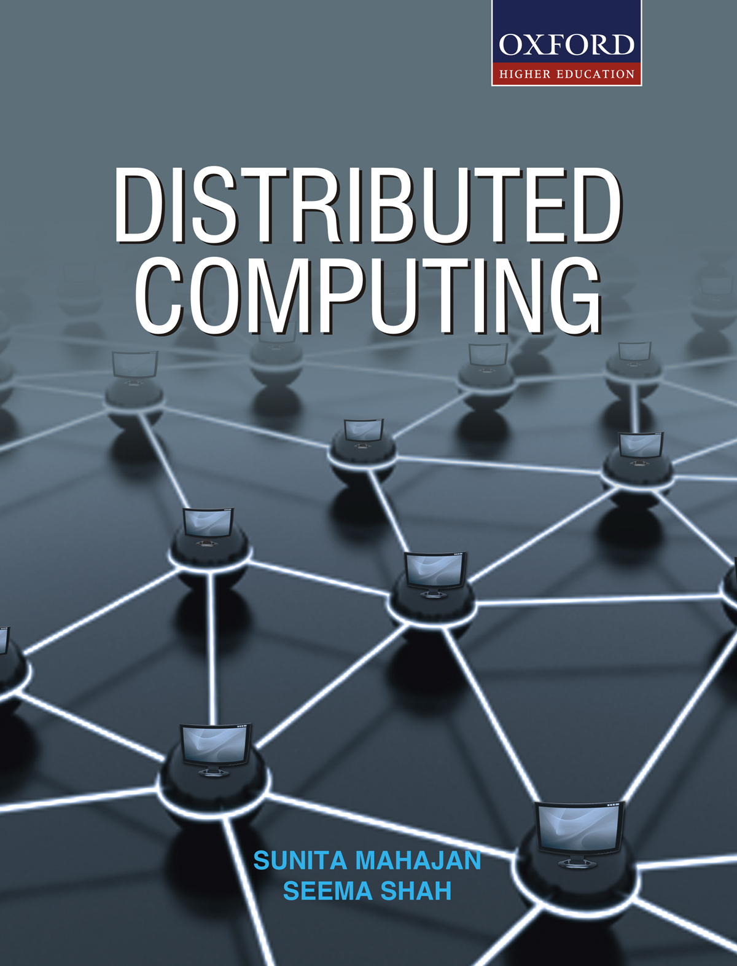
DISTRIBUTED COMPUTING
Sunita Mahajan, Principal, Institute of Computer Science, MET League of Colleges, Mumbai
Seema Shah, Principal, Vidyalankar Institute of Technology, Mumbai University

Slide 2
Chapter - 6
Distributed System Management

Slide 3
Topics
Introduction
Resource management
Task assignment approach
Load balancing approach
Load sharing approach
Process management in a distributed environment
Process migration
Threads
Fault tolerance

Slide 4
Introduction

Slide 5
Categories of Distributed System management
Resource management
Process management
Fault tolerance

Slide 6
Resource Management

Slide 7
Process scheduling techniques
Task assignment approach
Load balancing approach
Load sharing approach

Slide 8
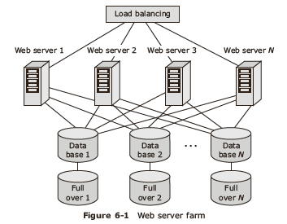
Example: Google system
Load balancing by using least loaded server
Proximity routing
Fault masking

Slide 9
Desirable features of a good global scheduling algorithm
No apriori knowledge about processes to be executed
Ability to make dynamic scheduling decisions
Flexible
Stable
Scalable
Unaffected by system failures

Slide 10
Task Assignment Approach

Slide 11
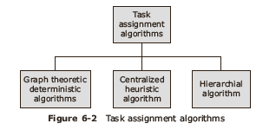
Task assignment
Minimize IPC costs
Less turnaround time for process completion
High degree of parallelism
Efficient usage of all system resources

Slide 12
Graph theoretic deterministic algorithm
A system with m CPUs and n processes has any of the following three cases:
m=n: Each process is allocated to one CPU
m<n: Some CPUs may remain idle or work on earlier allocated processes
m>n: There is a need to schedule processes on CPUs, and several processes may be assigned to each CPU.

Slide 13
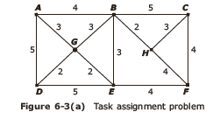
Example of graph theoretic deterministic algorithm-1
Weighted graph
  Each node is a process
  Each arc is message flowing between two processes

Slide 14
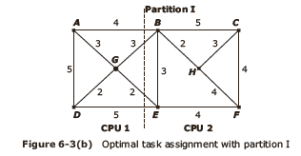
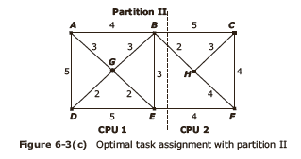
Example of graph theoretic deterministic algorithm-2

Slide 15
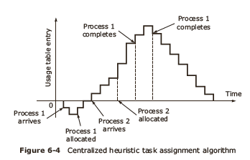
Centralized heuristic algorithm
Also called Top down algorithm
Allocated processing capacity fairly
2

Slide 16
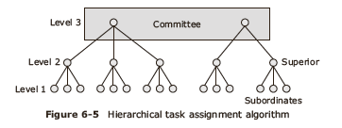
Hierarchical algorithm
Works between two levels in a group
Top of the tree is truncated into a committee which manages fault tolerance

Slide 17
Load Balancing Approach

Slide 18
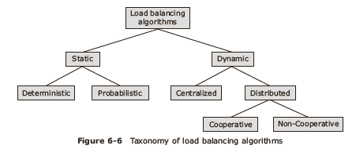
Load balancing Taxonomy
Improve resource utilization

Slide 19
Issues in designing in load balancing algorithms
Deciding policies for:
  Load estimation
  Process transfer
  Static information exchange
  Location
  Priority assignment
  Migration limitation

Slide 20
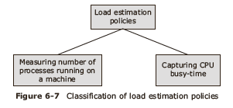
Policies for Load estimation
Parameters:
  Time dependent
  Node dependent

Slide 21
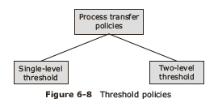
Policies for Process transfer
Threshold policy
  Static
  Dynamic

Slide 22
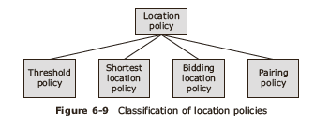
Location policies
Used to select destination node

Slide 23
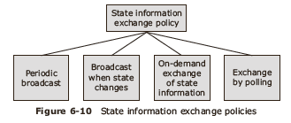
State information exchange
Dynamic policy
Decision based on state information

Slide 24
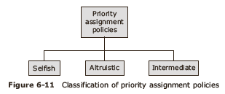
Priority assignment
To schedule local and remote processes at a node

Slide 25
Migration limiting policies
Uncontrolled policy
Controlled policy

Slide 26
Load Sharing Approach

Slide 27
Issues in designing load sharing algorithms
Load estimation policies
Process transfer policies
Location policies
State information exchange policies

Slide 28
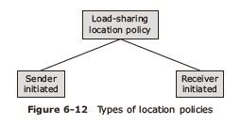
Location policies-1
Decides whether sender or receiver node process is to be migrated

Slide 29
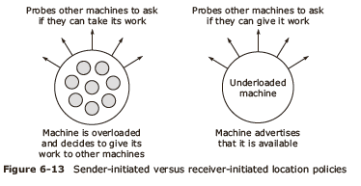
Location policies-2
Sender initiated algorithms make scheduling decisions at process arrival epoch
Receiver initiated algorithms make scheduling decisions at process departure epochs

Slide 30
State information exchange policies
Broadcast
Poll

Slide 31
Process Management In A Distributed Environment

Slide 32
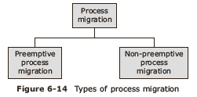
Functions of distributed process management
Process migration
  change of location and execution of a process from current processor to the destination processor

Slide 33
Desirable features of a good process migration mechanism
Transparency
Minimal interference
Minimal residual dependencies
Efficiency
Robustness
Ability to communicate between co processes of the job

Slide 34
Process Migration

Slide 35
Steps involved in process migration
Freezing process on the source node
Starting process on the destination node
Transporting process address space on destination node
Forward the messages addressed to migrated processes

Slide 36
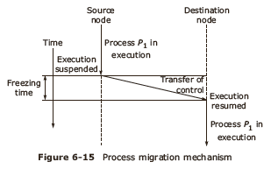
Mechanism

Slide 37
Freezing process on source node
Blocking sequence:
  Blocking the process immediately
  Wait for I/O operations to complete and then block the process.
Track information about open files
Create an empty process on the destination node
Transfer the migrant process and address space
Restart process on destination node

Slide 38
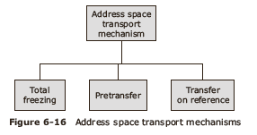
Address space transport mechanisms-1
Process address space:
  Process state: PCB information
  Process address space: Program code, data and stack

Slide 39
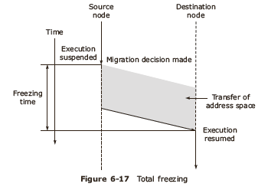
Address space transport mechanisms-2
Total freezing:
  Process execution stopped during address space transfer

Slide 40
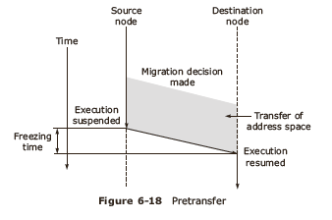
Address space transport mechanisms-3
Pre transfer:
  Address space is transferred while process continues to run on source node
  Highest priority in scheduling

Slide 41
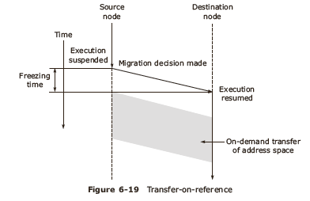
Address space transport mechanisms-4
Transfer-on –reference:
  Process state is transferred while address space is transferred on demand

Slide 42
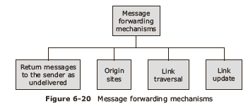
Message forwarding
Track and forward messages which have arrived on source node after process migration

Slide 43
Handle communication between cooperating processes
  Avoid separation of coprocesses
Home node concept
  Deployed in Sprite system

Slide 44
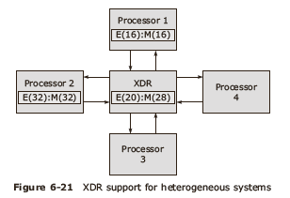
Process migration in heterogeneous systems
  Handling floating point numbers
Different sized exponents in XDR format
Handling overflow and underflow
Handling Mantissa
Handling signed infinity and zero representations

Slide 45
Advantages of process migration
Reduce average response time of heavily loaded nodes
Speed up of individual jobs
Better utilization of resources
Improve reliability of critical processes
Improving system security

Slide 46
Threads

Slide 47
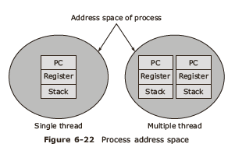
Process v/s threads
Analogy:
  Thread is to a process as process is to a machine

Slide 48
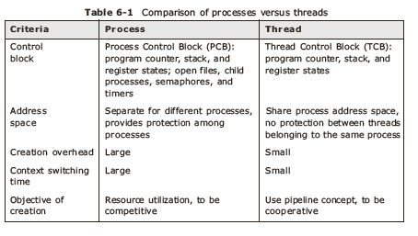
Comparison

Slide 49
Thread models
Dispatcher worker model
Team model
Pipeline model

Slide 50
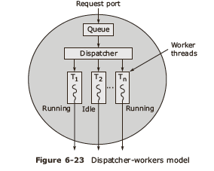
Thread: Dispatcher worker model

Slide 51
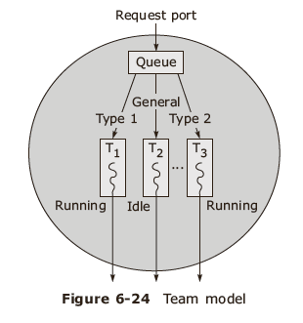
Thread: Team model

Slide 52
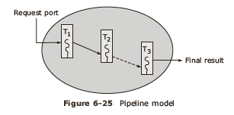
Thread: Pipeline model

Slide 53
Design issues in threads
Thread semantics
  Thread creation, termination
Thread synchronization
Thread scheduling

Slide 54
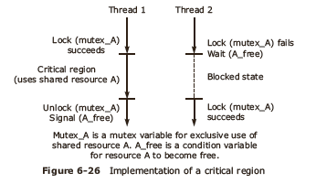
Thread synchronization
Execution in Critical region
  Use binary semaphore

Slide 55
Threads scheduling
Priority assignment facility
Choice of dynamic variation of quantum size
Handoff scheduling scheme
Affinity scheduling scheme
Signals used for providing interrupts and exceptions

Slide 56
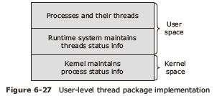

Implementing thread package
User level approach
Kernel level approach

Slide 57
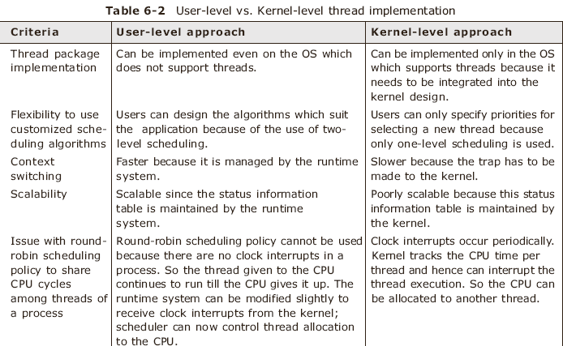
Comparison of thread implementation-1

Slide 58
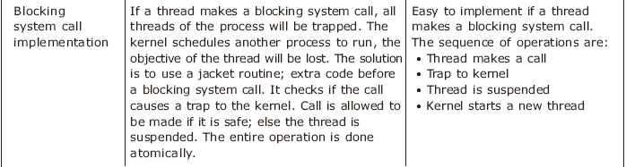
Comparison of thread implementation-2

Slide 59
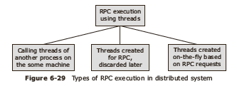
Threads and Remote execution
RPC
RMI and Java threads

Slide 60
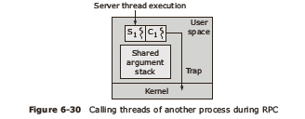
RPC execution

Slide 61
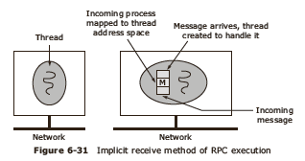
Threads are created on the fly

Slide 62
Fault Tolerance

Slide 63
Component faults
Transient faults
Intermittent faults
Permanent faults
∞
Mean time to failure = ∑ kp (1-p) ^{k-1}
k=1
Mean time to failure = 1/p

Slide 64
System failures
Fail silent faults / fail stop faults
Byzantine faults

Slide 65
Use of redundancy
Information redundancy
Time redundancy
Physical redundancy
  Active replication
  Primary backup methods

Slide 66
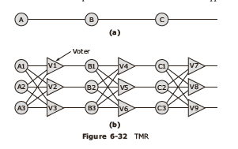
Active replication-1
State machine approach
(TMR -Triple Modular Redundancy)

Slide 67
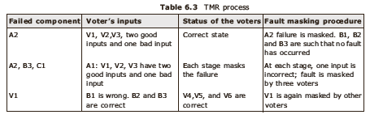
Active replication-2

Slide 68
Primary backup
Uses two machines :
  Primary and backup
Uses limited number of messages such that these messages go only to the primary server and no ordering is required

Slide 69
Summary
Introduction
Resource management
Task assignment approach
Load balancing approach
Load sharing approach
Process management in a distributed environment
Process migration
Threads
Fault tolerance

